Slide 1

Real Estate Sampling in Ames, Iowa (2006 - 2010)
Sudip Bhattacharyya & Dan Freeman

Slide 2
Task 1

Slide 3
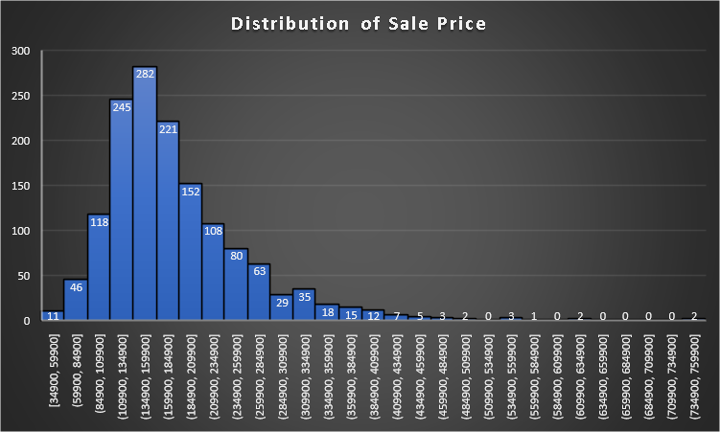
Objective & Dataset
Comparative study between different sampling designs in drawing sufficiently sized samples from population in order to obtain information on population characteristics.
Dataset
Dataset provides the house sale prices in 25 different neighborhoods of Ames, Iowa in between 2006 and 2010
Dataset contains 81 variables (categorical and continuous) across 1,460 house-sales between 2006 and 2010
Variables cover aspects such as Sale Price, Zoning, Neighborhood, Lot Size and Character, Age of the Property, House Style, Foundation, Total Area, Number of Rooms, Garage Quality, Additional Features, etc.
Sampling designs focus on Neighborhood, House Style, Gross Living Area and Sale Price
Population Overview
Average sale price is parameter of interest
Population size (N) = 1,460
Population average sale price for population (µ) = $180,921
Population standard deviation of sale price (σ) = $79,415
Sale price ranges from $35,000 to above $750,000
Over 50% of houses cost between $110,000 and $185,000
Sale price has right skewed distribution due to a few expensive houses

Slide 4
Sample Designs & Sample Size Determination
Consider four different sample designs in this study:
Simple Random Sampling
Stratified Sampling with Proportional Allocation
Stratified Sampling with Neyman Allocation
Two-stage Sampling
With CLT and large sample size, assume normality in population distribution despite observed skewness.
Margin of error = $10,000 (approximately 5% of average sale price in population)
Initial sample size:
n_{0,srs} = (z_{95%})² * s² / (I_{95%})² = (1.96)²*(79415)²/(10000)² = 242
Final sample size:
n_{srs} = n_{0,srs} / (1 + n_{0,srs} /N) = 242 / (1+ 242/1460) = 208
Consider sample size of 208 houses for all four sampling methods irrespective of complexity of the designs.

Slide 5
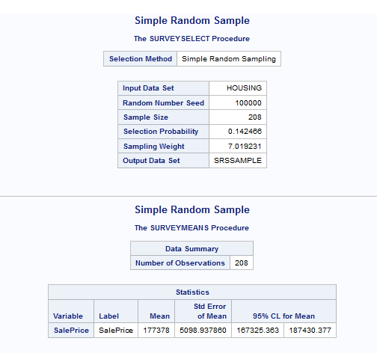
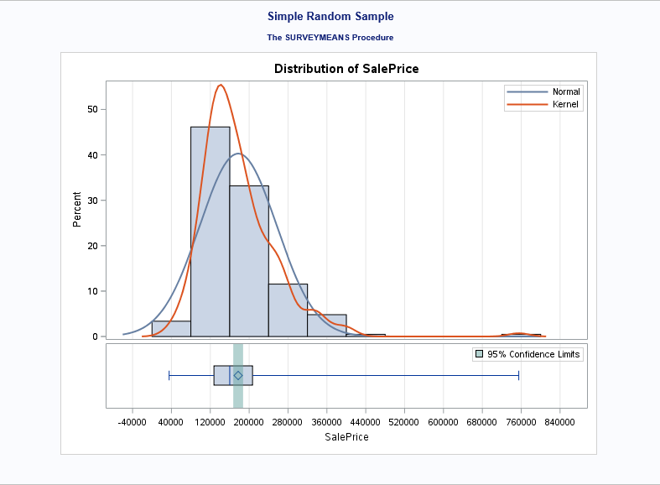
Design 1: Simple Random Sampling
Simple random sampling performed on the entire dataset to estimate population mean sale price.
Sampling Results (Output from SAS)
Sample mean (x-bar) = 177,378
SE of sample mean (s) = 5,099
95% CI for sample mean = [167,325, 187,430]

Slide 6
Design 2: Stratified Sampling with Proportional Allocation
Stratified sampling with proportional allocation is done to estimate average sale price with House Style used as stratification variable.
Stratum Sample Sizes
Stratum | House Style | No. of Houses (N_{h}) | Proportion (p_{h}) | Sample Size (n_{h})
Stratum 1 | 1 Story | 726 | 0.4973 | 103
Stratum 2 | 1.5 Fin | 154 | 0.1055 | 22
Stratum 3 | 1.5 Unf | 14 | 0.0096 | 2
Stratum 4 | 2 Story | 445 | 0.3048 | 64
Stratum 5 | 2.5 Fin | 8 | 0.0055 | 1
Stratum 6 | 2.5 Unf | 11 | 0.0075 | 2
Stratum 7 | Sfoyer | 37 | 0.0253 | 5
Stratum 8 | SLvl | 65 | 0.0445 | 9
Total |  | 1460 |  | 208

Slide 7
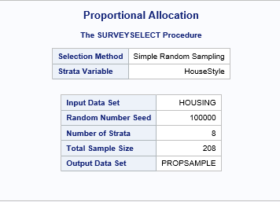
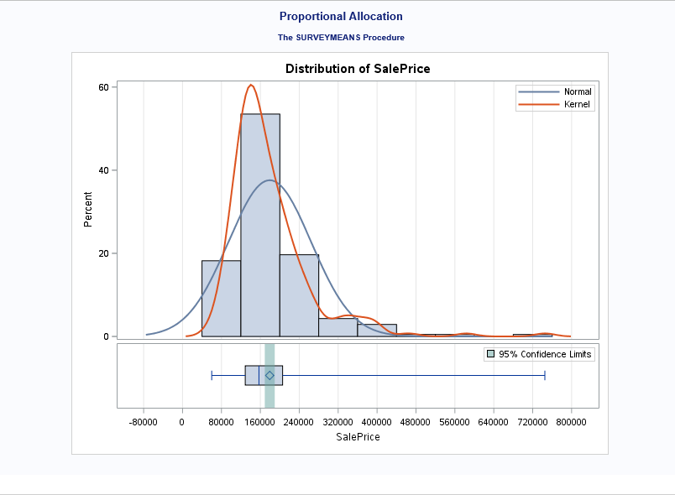
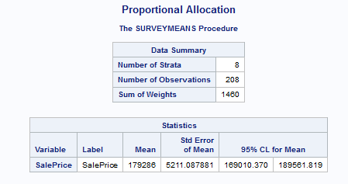
Design 2 (Contd..)
Sampling Results (Output from SAS)
Sample mean (x-bar) = 179,286
SE of sample mean (s) = 5,211
95% CI for sample mean = [169,010, 189,562]

Slide 8
Design 3: Stratified Sampling with Neyman Allocation
Stratified sampling with Neyman allocation is done to estimate average sale price with House Style used as stratification variable and Gross Living Area for calculating variance between strata.
Stratum Sample Sizes
Stratum | House Style | No. Of Houses (N_{h}) | Average Gross Living Area | Std Dev Gross Living Area (s_{h}) | N_{h}*s_{h} | Sample Size (n_{h})
Stratum 1 | 1 Story | 726 | 1,309 | 381 | 276,606 | 92
Stratum 2 | 1.5 Fin | 154 | 1,565 | 445 | 68,530 | 23
Stratum 3 | 1.5 Unf | 14 | 896 | 110 | 1,540 | 0
Stratum 4 | 2 Story | 445 | 1,887 | 528 | 234,960 | 78
Stratum 5 | 2.5 Fin | 8 | 2,848 | 613 | 4,904 | 2
Stratum 6 | 2.5 Unf | 11 | 1,908 | 445 | 4,895 | 2
Stratum 7 | Sfoyer | 37 | 973 | 280 | 10,360 | 3
Stratum 8 | SLvl | 65 | 1,374 | 387 | 25,155 | 8
Total |  | 1,460 |  |  | 626,950 | 208

Slide 9
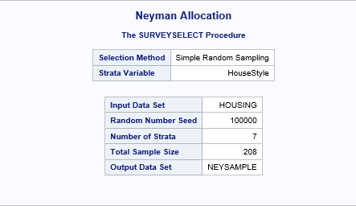
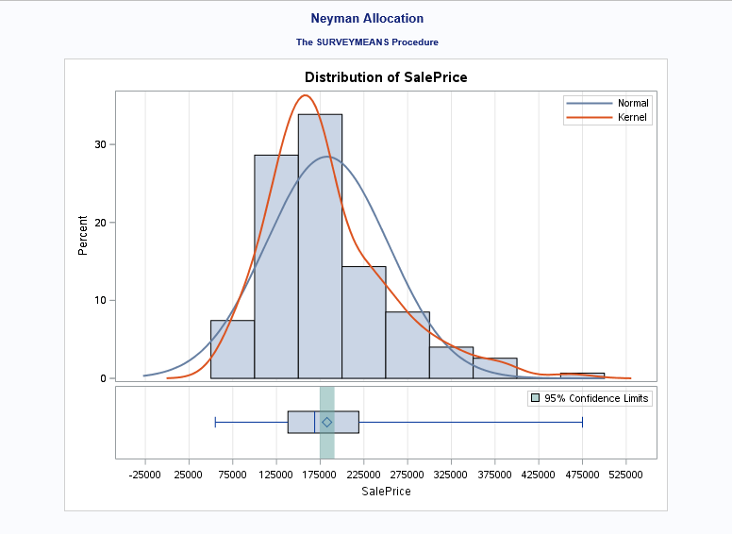
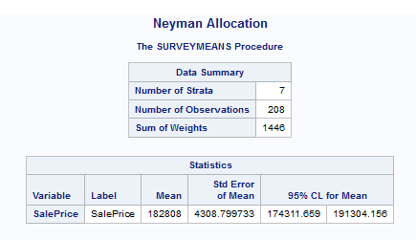
Design 3 (Contd..)
Sampling Results (Output from SAS)
Sample mean (x-bar) = 182,808
SE of sample mean (s) = 4,309
95% CI for sample mean = [174,312, 191,304]

Slide 10
Design 4: Two Stage Sampling
Conducted two-stage sampling to estimate average sale price in which clusters were formed based on Neighborhood in the first stage and sales were sampled from selected neighborhoods with stratification based on House Style in the second stage.
Design Structure
Total number of PSU’s (M) = 25
Selected number of PSU’s (m) = 5
Number of population units in selected PSU’s (N) = 141
N₁ = 16, N₂ = 17, N₃ = 9, N₄ = 74, N₅ = 25 where N_{i} = number of SSU’s in i^{th} PSU
Total sample size (n) = 28
Using stratification based on House Style with proportional allocation, the sample sizes for 5 neighborhoods are as follows:
n₁ = 1, n₂ = 15, n₃ = 8, n₄ = 3, n₅ = 1 where n_{i} = selected number of SSU’s from i^{th} PSU

Slide 11
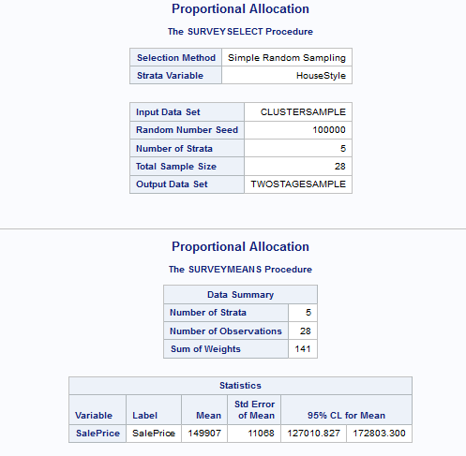
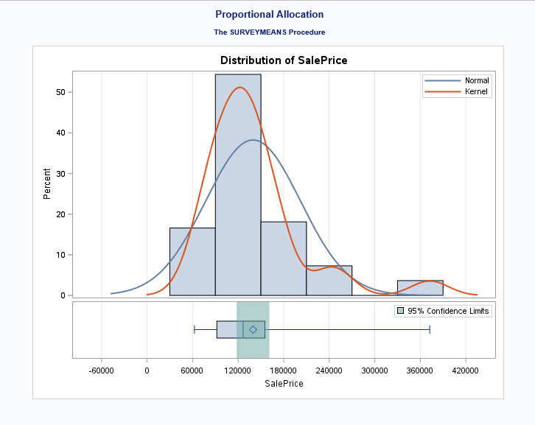
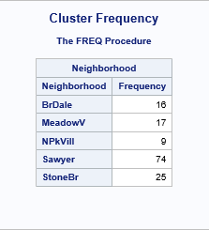
Design 4 (Contd..)
Sampling Results (Output from SAS)
Sample mean (x-bar) = 149,907
SE of sample mean (s) = 11,068
95% CI for sample mean = [127,010, 172,803]

Slide 12
Comparison between Sample Designs
Sample Designs | Sample Mean | Standard Error of Sample Mean | Confidence Interval | Design Effect
Simple Random Sampling | 177,378 | 5,099 | [167,325, 187,430] | -
Stratified Sampling (Proportional Allocation) | 179,286 | 5,211 | [169,010, 189,562] | 1.04
Stratified Sampling (Neyman Allocation) | 182,808 | 4,309 | [174,311, 191,304] | 0.71
Two-Stage Sampling | 149,907 | 11,068 | [127,010, 172,803]
Stratified sampling design with Neyman allocation provides:
Closest estimate (x-bar = 182,808) to population mean (μ= 180,921)
Lowest standard error (SE = 4,309)
Narrowest confidence interval (CI = [174,311, 191,304])
Design effect with:
Stratified design with proportional allocation = 1.04, indicates required sample size of 217 units to achieve an equal precision in estimation as compared to 208 in simple random sampling
Stratified design with Neyman allocation = 0.71, indicates 149 sample units are needed to achieve an equal precision as compared to 208 for simple random sampling

Slide 13
Task 2

Slide 14
Objective & Results
To select five random samples from our population of 1,460 houses for each of the four sampling techniques we use in Task 1 and count the number of samples for which the 95% confidence interval contain the population mean sale price of $180,921 for each sampling technique.
Design | Iteration | Mean | Standard Error | Lower 95% CL | Upper 95% CL | Percentage of CI's Containing Population Mean
Simple Random Sample | 1 | 175,784 | 4,614 | 166,689 | 184,880 | 80%
 | 2 | 187,675 | 5,572 | 176,690 | 198,659
 | 3 | 176,136 | 4,282 | 167,694 | 184,578
 | 4 | 169,466 | 4,013 | 161,555 | 177,377
 | 5 | 178,916 | 4,601 | 169,845 | 187,988
Proportional | 1 | 184,572 | 5,776 | 173,183 | 195,961 | 100%
 | 2 | 182,511 | 5,104 | 172,448 | 192,575
 | 3 | 188,214 | 5,180 | 178,000 | 198,428
 | 4 | 176,537 | 4,556 | 167,554 | 185,520
 | 5 | 186,368 | 5,344 | 175,831 | 196,906
Neyman | 1 | 188,179 | 5,111 | 178,100 | 198,257 | 100%
 | 2 | 181,245 | 5,092 | 171,204 | 191,286
 | 3 | 177,541 | 4,758 | 168,160 | 186,923
 | 4 | 184,498 | 4,910 | 174,816 | 194,180
 | 5 | 176,185 | 4,481 | 167,348 | 185,021
Two-stage (Cluster & Proportional) | 1 | 201,383 | 20,516 | 158,942 | 243,825 | 60%
 | 2 | 187,035 | 16,396 | 153,117 | 220,952
 | 3 | 137,012 | 8,782 | 118,844 | 155,180
 | 4 | 184,621 | 17,095 | 149,256 | 219,986
 | 5 | 139,561 | 8,519 | 121,938 | 157,184

Slide 15
Inferences
Design | Average Mean | Average Standard Error
Simple Random Sample | 177,595 | 4,616
Proportional | 183,640 | 5,192
Neyman | 181,530 | 4,871
Two-stage (Cluster & Proportional) | 169,922 | 14,262
Mean of average house sale prices under SRS based on 5 samples is more than $3,000 lower than the population mean
Stratified sampling with proportional allocation yields an average sale price almost $2,000 above the population mean
Stratified sampling with Neyman allocation comes the closest in predicting the population mean with a sample average of $181,530 across the five samples, merely $609 higher than population mean
SRS method has the lowest average standard error at $4,616 while the Neyman method comes in second at an average of $4,871
80% of the confidence intervals for sample mean under SRS capture the population mean whereas stratified sampling captures it in all cases
Confidence intervals for sample mean fails to contain population mean in 40% cases for two stage design
Overall, stratification following Neyman allocation produces the perfect balance between accuracy (minimal bias) and precision (minimal variance)

Slide 16
Thank You

